Slide 1
A Scalable Deep Neural Network Architecture for Multi-Building and Multi-Floor Indoor Localization Based on Wi-Fi Fingerprinting
Kyeong Soo Kim Sanghyuk Lee Kaizhu Huang

Slide 2
Abstract
This paper reports the current status of investigation on the use of deep neural networks (DNNs) for scalable building/floor classification and floor-level position estimation based on Wi-Fi fingerprinting.
It proposes a new DNN architecture consisting of a stacked autoencoder for the reduction of feature space dimension and a feed-forward classifier for multi-label classification of building/floor/location, on which the multi-building and multi-floor indoor localization system based on Wi-Fi fingerprinting is built.

Slide 3
Introduction
Location fingerprinting using received signal strengths (RSSs) from wireless network infrastructure is one of the most popular for localization in an indoor environment, where there is no line-of-sight signal from the global positioning system (GPS) available For example, a vector of pairs of a service set identifier (SSID) and an RSS for a Wi-Fi access point (AP) measured at a location can be its location fingerprint.
A location of a user/device then can be estimated by finding the closest match between its RSS measurement and the fingerprints of known locations in a database.
It is based on the existing wireless infrastructure.
Building estimation is done as follows: Given the AP with the strongest RSS in a measured fingerprint, we first build a subset of fingerprints where the same AP has the strongest RSS; then, we count the number of fingerprints associated to each building and set the estimated building to be the most frequent one from the counting.
For the estimation of the coordinates of the location, we first build a subset of fingerprints belonging to the building and the floor estimated from the previous procedures. Then, take multiple fingerprints from the subset most similar to the measured one, and compute the centroid of the coordinates of the selected fingerprints as the estimated coordinates of the given location.

Slide 4
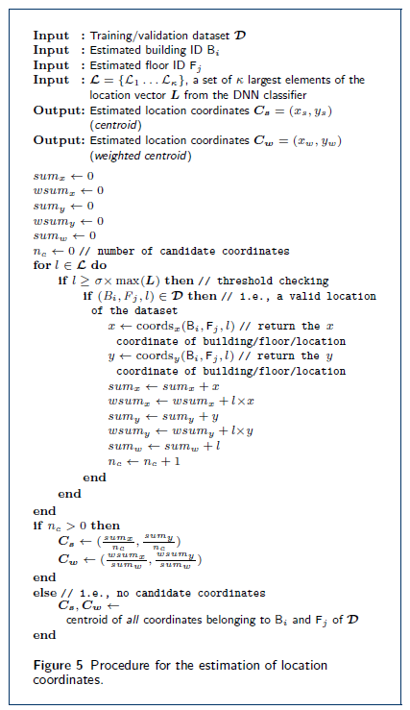
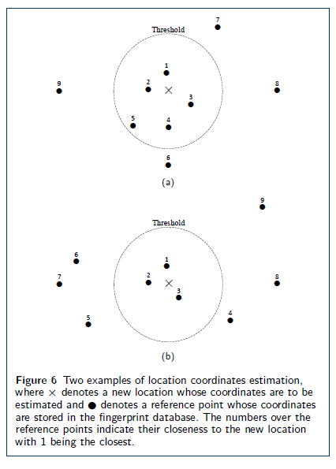

Slide 5
Introduction (contd..)
In this paper, we report the current status of our investigation on the use of DNNs for scalable building/floor classification and floor-level location estimation.
We propose a new DNN architecture consisting of an SAE for the reduction of feature space dimension and a feed-forward multi-label classifier for a multi-building and multi-floor indoor localization system based on Wi-Fi fingerprinting and evaluate its performance using the UJIIndoorLoc dataset

Slide 6
A Scalable DNN Architecture for Multi-Building and Multi-Floor Indoor Localization
A major disadvantage in hierarchical DNN architecture is that the DNNs in the floor and the location levels of the system need to be trained separately with multiple sub-datasets derived from a common dataset (i.e., building-specific datasets for DNNs for floor estimation and building floor-specific datasets for DNNs for location estimation), which poses significant challenges on the management of location fingerprint databases as well as the training of possibly a large number of DNNs. Therefore, we focus on the integrated architecture where a single DNN handles the classification of building, floor, and location in an integrated way with a common dataset.
We propose a scalable DNN architecture based on multi-label classification.

Slide 7
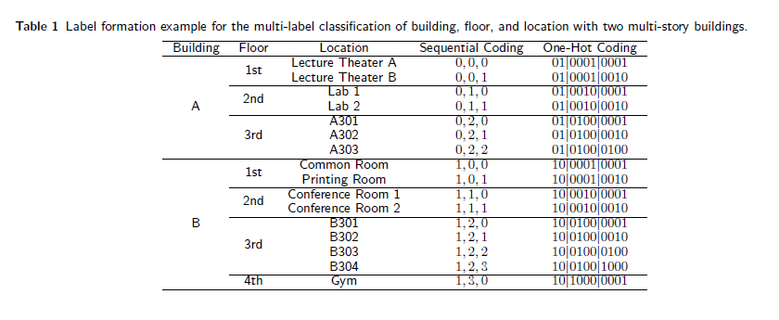
First, building, floor, and location identifiers are mapped to sequential numbers, the latter two of which are meaningful only in combination with higher level numbers; those numbers are one-hot encoded independently and combined together into a vector as a categorical variable for multi-label classification.
Then, the output vector from the multi-label classifier is split into a building, a floor, and a location vector by indexes.
Finally, we estimate the building and the floor of a location as the index of a maximum value of the corresponding vector through the arg max function.
For the estimation of the location coordinates, we select largest elements from the location vector (i.e., L=(L₁, . . . , L_{max}(...,_{NL(i.j)} )), filter out the elements whose values are less than σ×max(L)(σ Є [0, 1]), and calculate the estimated coordinates of the location as either the normal or weighted (with the values of the elements as weights) centroid of the remaining elements.
There are two design parameters in the location coordinates estimation procedure= k and σ.

Slide 8
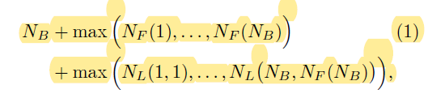
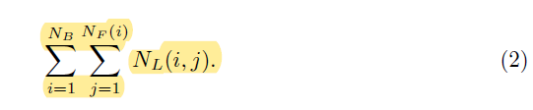
As for the scalability of the proposed DNN architecture, the number of output nodes becomes much smaller than that of the DNN architecture based on multi-class classification: The number of output nodes for multi-label building/floor/location classification is given by:
where NB, NF (i), and NL(j, k) are the number of buildings in the complex, the number of floors in the ith building (i = 1, . . . ,NB), and the number of locations on the kth floor of the jth building (j = 1, . . . ,NB; k = 1, . . . ,NF (j)), respectively.
For multi-class building/floor/location classification, the number becomes:
The number of output nodes of the proposed DNN architecture for the publicly available UJIIndoorLoc dataset is given by 118 (i.e., the sum of the number of buildings (3), the maximum of the numbers of floors of the buildings (5), and the maximum of the numbers of locations on the floors (110)), which is smaller than the number of output nodes of the DNN architecture based on multi-class classification (i.e., 905).

Slide 9
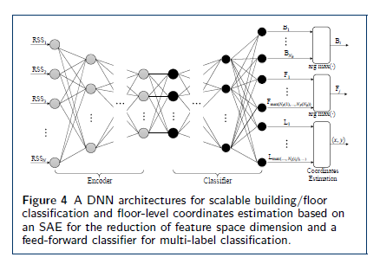
Due to the clear mapping between building, floor, and location identifiers and its corresponding one-hot-encoded categorical variable for the DNNbased multi-label classifier, it is easy to carry out different processing for parts of DNN outputs specifically for building, floor, and location.
The use of multiple elements in estimating location coordinates is a huge advantage in terms of computational complexity because trained DNNs can generate multi-dimensional output values in parallel.

Slide 10
Experiment
Carried out experiments using the UJIIndoorLoc dataset.
We focus on the effects of the number of largest elements from the output location vector (i.e., ) and the scaling factor for a threshold (i.e., ) in the location coordinates estimation procedure.
Splitting the training data into new training and validation data with the ratio of 70:30 for DNN training and validation with building/floor/location labels for both. During the evaluation phase, the output from the trained DNN are post-processed and compared with the building, floor, and coordinates of a given location.
The best results are achieved when k=8 and σ=0.2, which are highlighted in gray. These results from the proposed DNN-based multi-building and multi-floor indoor localization system — i.e., 99.82 % for building hit rate, 91.27 % for floor hit rate, 91.18 % for success rate and 9.29m for positioning error — are favorably comparable to the baseline results — i.e., 89.92 % for success rate and 7.9m for positioning error— which are based on the distance-based k-Nearest Neighbors (kNN) algorithm.

Slide 11
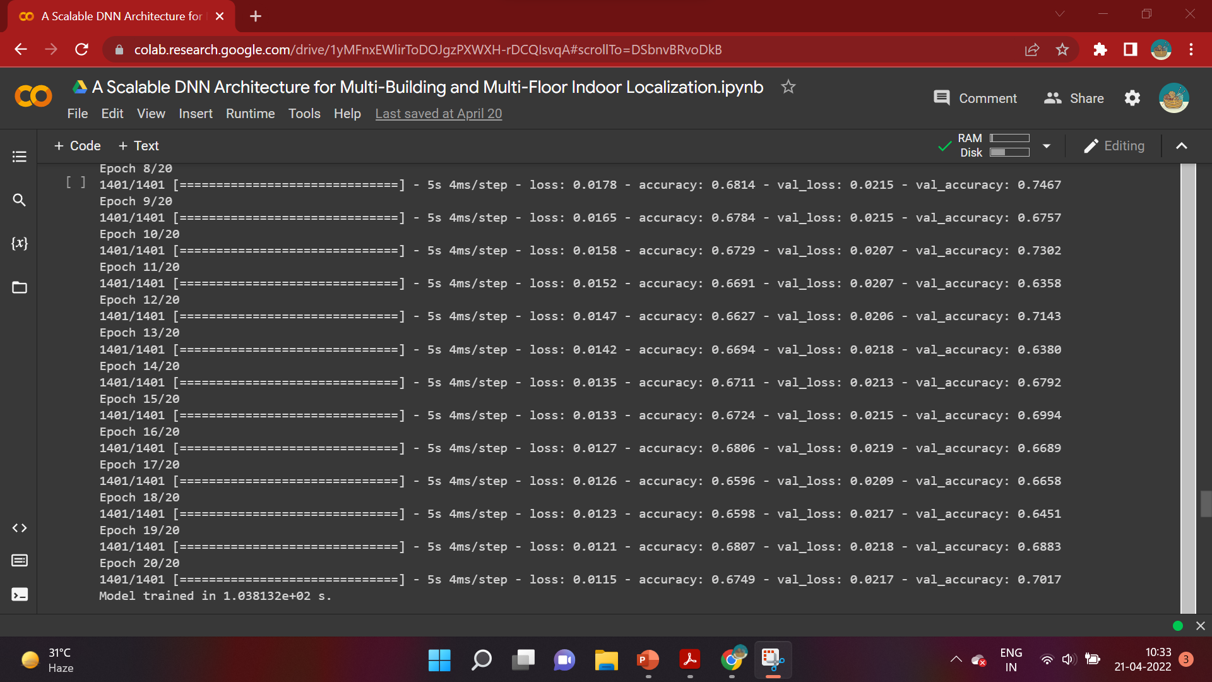
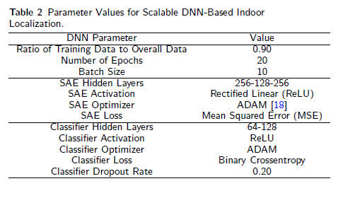
Implementation

Slide 12
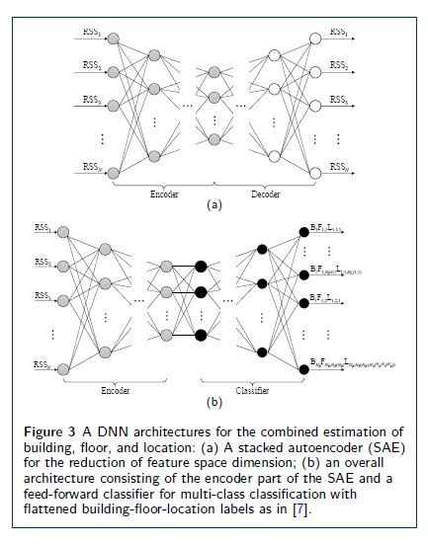
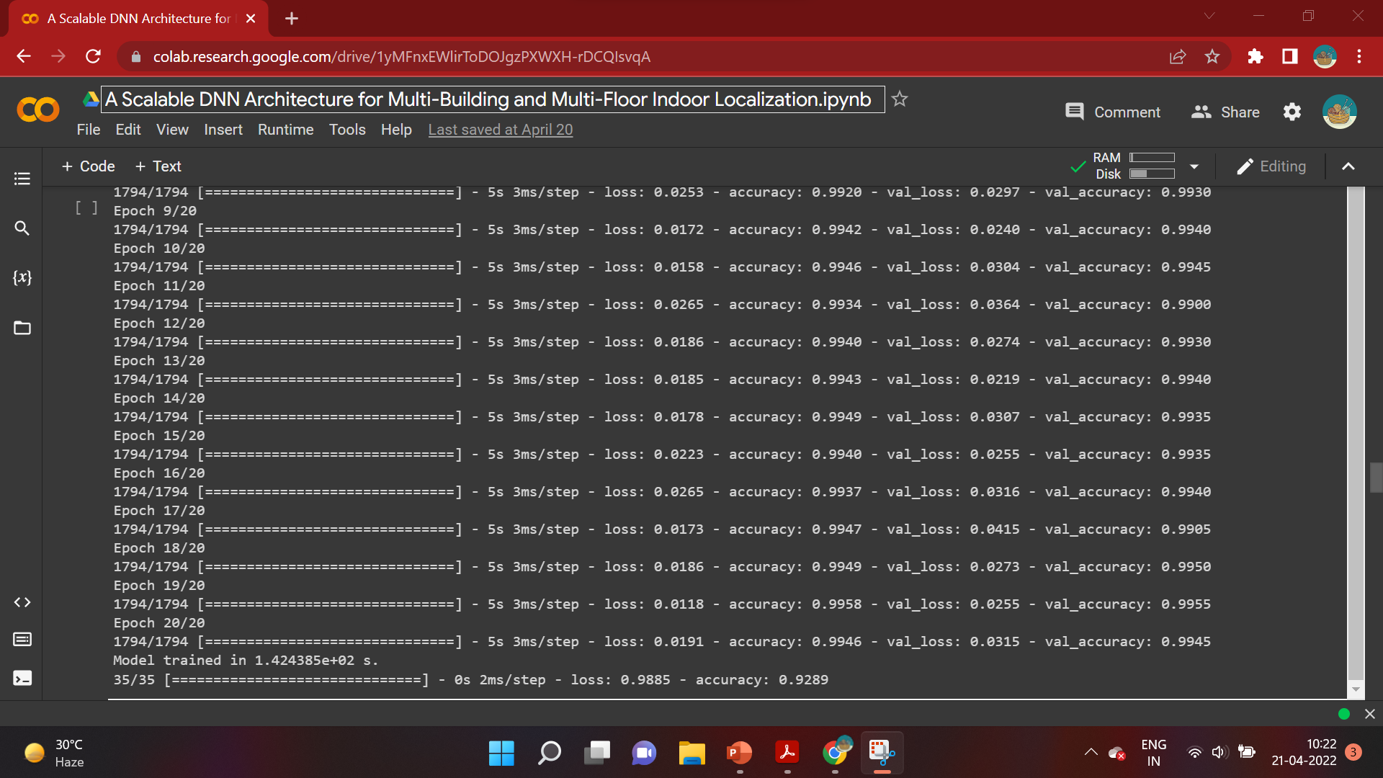
Implementation

Slide 13
Conclusion
proposed a new scalable DNN architecture for multi-building and multi-floor indoor cover a large-scale complex of many multi-story buildings under the same management.
The proposed DNN architecture consists of an SAE for the reduction of feature space dimension and a feed-forward classifier for multi-label classification of building/floor/location. Reformulating the problem of building/floor/location classification based on the framework of multi-label classification, we can achieve better scalability.
Better exploit the hierarchical nature of the building/floor estimation and the floor-level location coordinates estimation through systematic label formation (i.e., providing straightforward mapping between a DNN categorical variable and building, floor & location vectors).
Combined with the unique advantage of a DNN-based indoor localization system that, once trained, it does not need the fingerprint database any longer but carries the necessary information for localization in DNN weights.

Slide 14
Future Scope
The scalable DNN architecture proposed in this paper could open a door for a future secure and energy-efficient indoor localization solution exclusively running on mobile devices without exchanging any data with the server.
The experimental results are preliminary and not based on optimized DNN parameters; there are still much room for further optimization of the performance through DNN parameter tuning and the investigation of the performance and complexity trade-off.
There is no direct match between the cost function used in DNN training/validation and the actual performance in the final evaluation for building/ floor detection and the location coordinates estimation due to the additional processing of DNN output.
To fully take into account the actual performance of building/floor detection and location coordinates estimation during training/validation, we may consider heuristics like evolutionary algorithms (e.g., genetic algorithm (GA) and particle swarm optimization (PSO) , simulated annealing, and quantum annealing for training DNN weights.

Slide 15
References
1. He, S., Chan, S.-H.G.: Wi-Fi fingerprint-based indoor positioning: Recent advances and comparisons. IEEE Commun. Surveys Tuts. 18(1), 466–490 (2016)
2. Bahl, P., Padmanabhan, V.N.: RADAR: An in-building RF-based user location and tracking system. In: Proc. 2000 IEEE INFOCOM, vol. 2,pp. 775–784 (2000). doi:10.1109/INFCOM.2000.832252
3. Moreira, A., Nicolau, M.J., Meneses, F., Costa, A.: Wi-Fi fingerprinting in the real world – RTLSUM at the EvAAL competition.In: Proc. International Conference on Indoor Positioning and Indoor Navigation (IPIN), Banff, Alberta, Canada, pp. 1–10 (2015)
4. Torres-Sospedra, J., Montoliu, R., Mart´ınez-Us´o, A., Avariento, J.P., Arnau, T.J., Benedito-Bordonau, M., Huerta, J.: UJIIndoorLoc: A new multi-building and multi-floor database for wlan fingerprint-based indoor localization problems. In: Proc. International Conference on Indoor Positioning and Indoor Navigation (IPIN), Busan, Korea, pp.261–270 (2014)

Slide 16
Thank You

